Slide 1

Rockbuster Data Analysis
By Vineeta Sinha
12/9/2023

Slide 2
Motivation & Objective
Rockbuster Stealth, a fictional company that provides online movie rentals. Facing stiff competition from streaming services like Netflix & Amazon Prime, the business intelligence department wanted help in launching strategies for the new online video service, in order to stay competitive.

Slide 3

Questions & Findings
Which movies contributed to most, least revenue gains?
What was the average rental duration for all videos?
Which countries are Rockbuster customers based in?
Where are customers with high lifetime value based?
Do sales figure vary between geographical regions?

Slide 4








Analysis Overview
Average Rent $2.98
Average duration - 5days
Average length – 115min
Total customers - 599
Average replacement cost - $20
Total countries - 109
Total Revenue Collected - $61,312

Slide 5
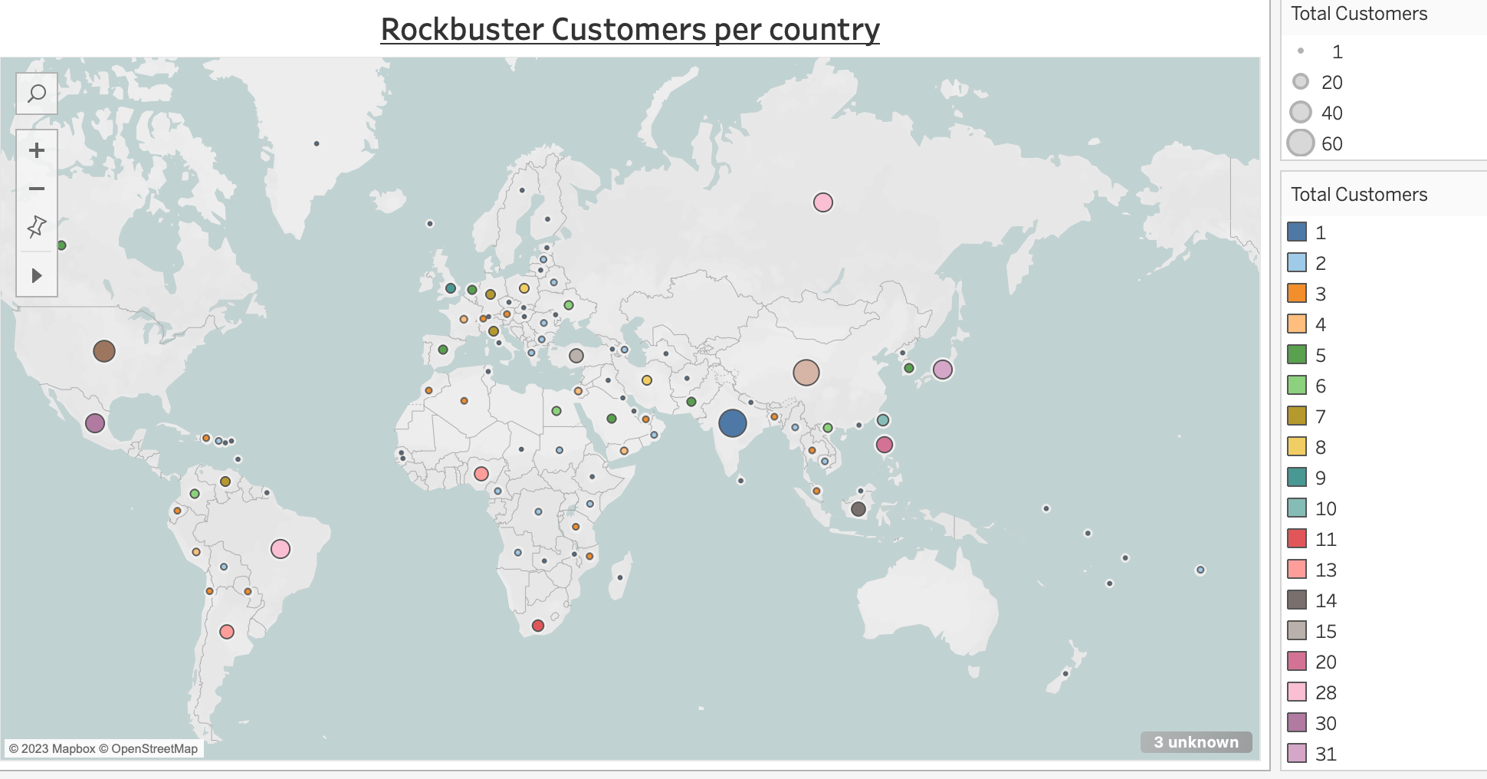

Rockbuster Customers all over the World!
Total Countries – 109
Total Customers – 599
Total Revenue - $61,312

Slide 6

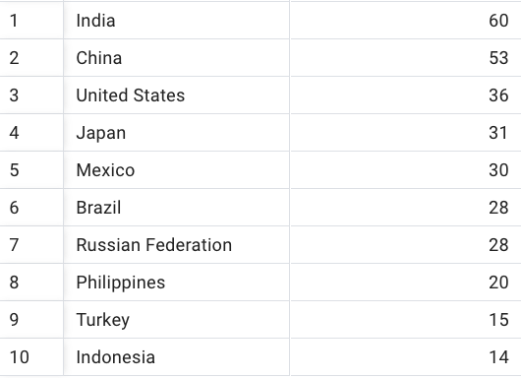
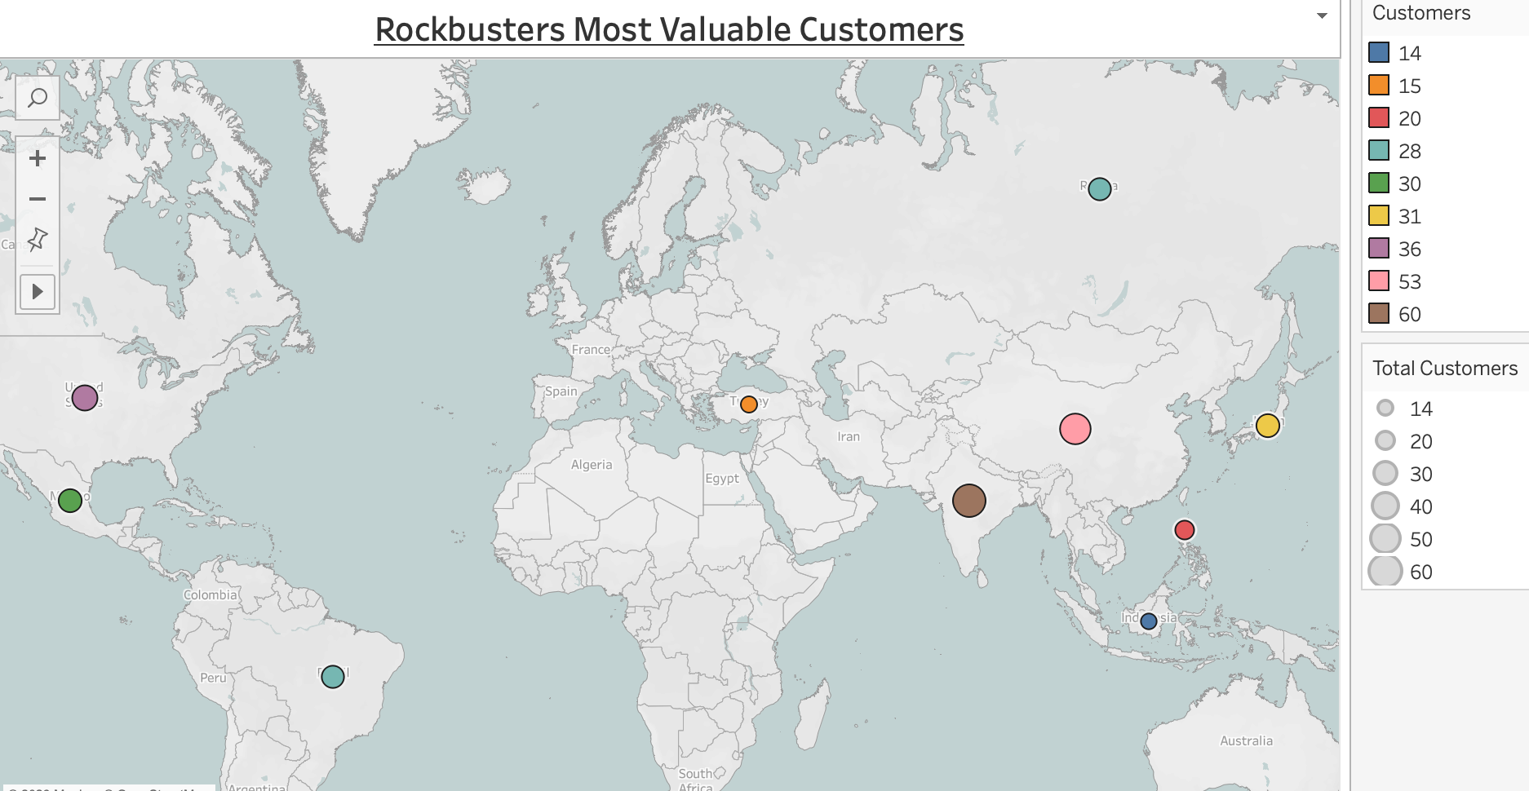
Top 10 Countries having most customers

Slide 7
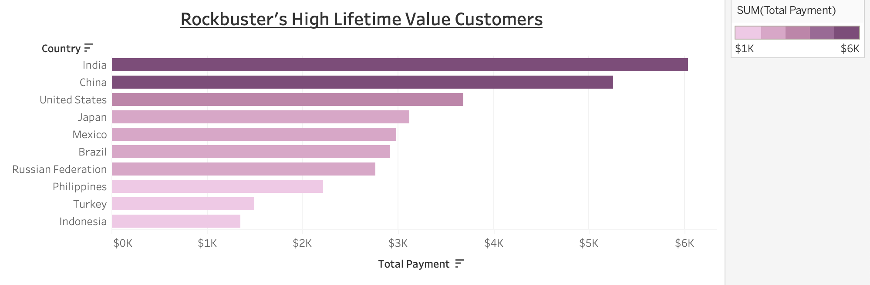
Most Valuable Customers

Slide 8
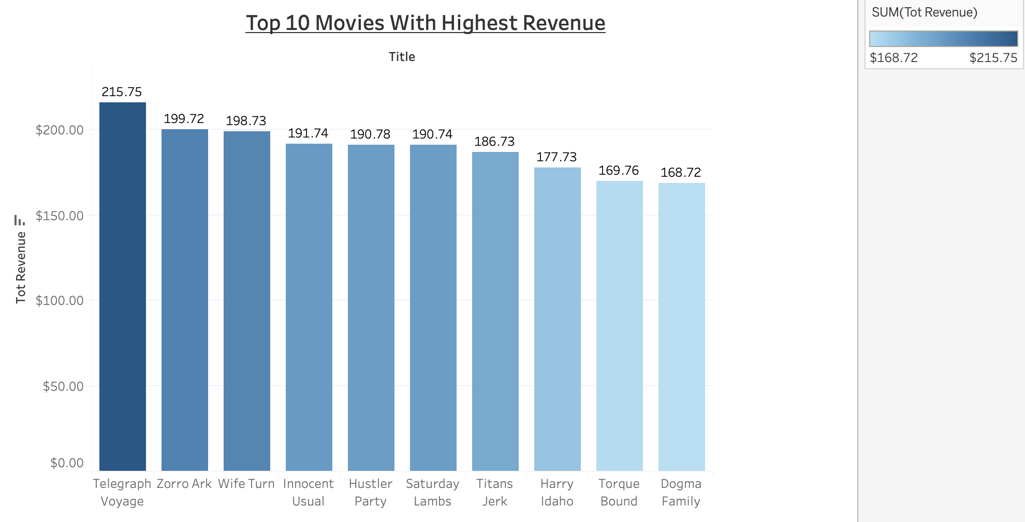
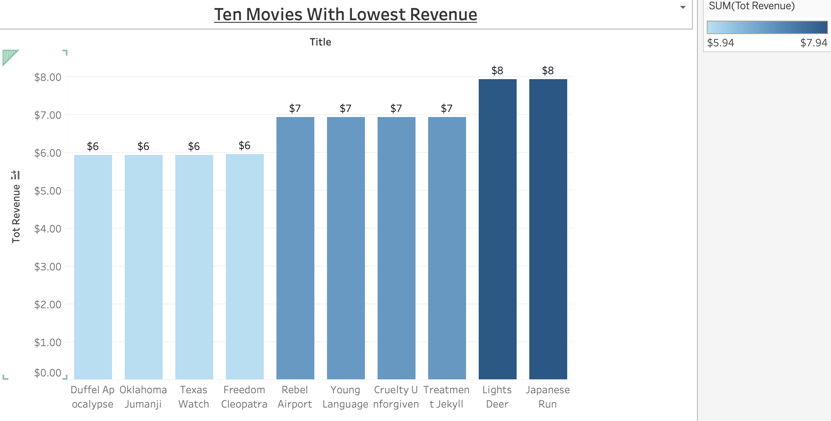
Movies with most/least revenue gains

Slide 9

Conclusion & Recommendations
The number of Movies with most revenue gains should be increased
Attention should be paid on the time of the year when most of the movies are rented and customer choices.
Most popular category of films in terms of number of rentals
Customer feedback can provide insight regarding movies popularity in terms of actors, genre, language, rental duration etc.
Are the movies available in the stores or can be rented online?
Customer preference for in-person DVD rentals vs watching online
Finding which streaming services held the most and highest rated movies.

Slide 10

Thank You!

Slide 11
Rockbuster Analysis Links
Rockbuster Customers per country.
Rockbuster Lifetime Value Customers.
Rockbusters Top 10 movies with highest revenues.
Rockbust movies with lowest revenues.

